Slide 1
E-Learning Portal
-By
Atharva Patil

Slide 2
About Project
An E-learning portal created using JSP Servlets.
Technologies used are :
Java
Maven
Apache Tomcat Server 9.0
MySQL

Slide 3
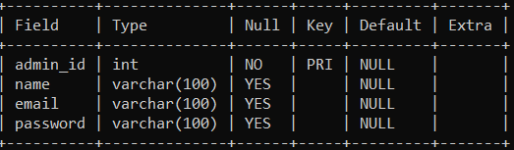
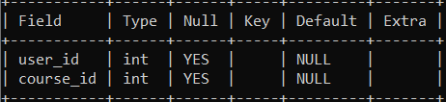
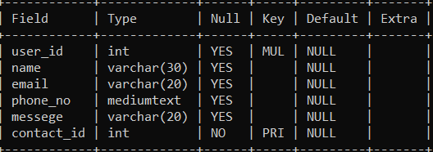
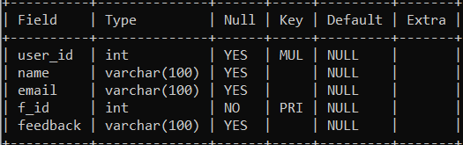
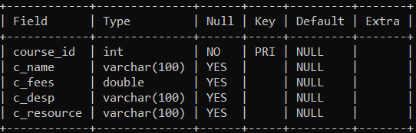
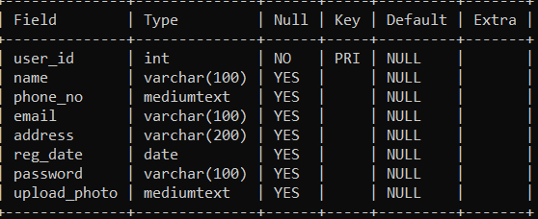
Database Table Structures
Admin
Enroll
Contact
Feedback
Course
User

Slide 4
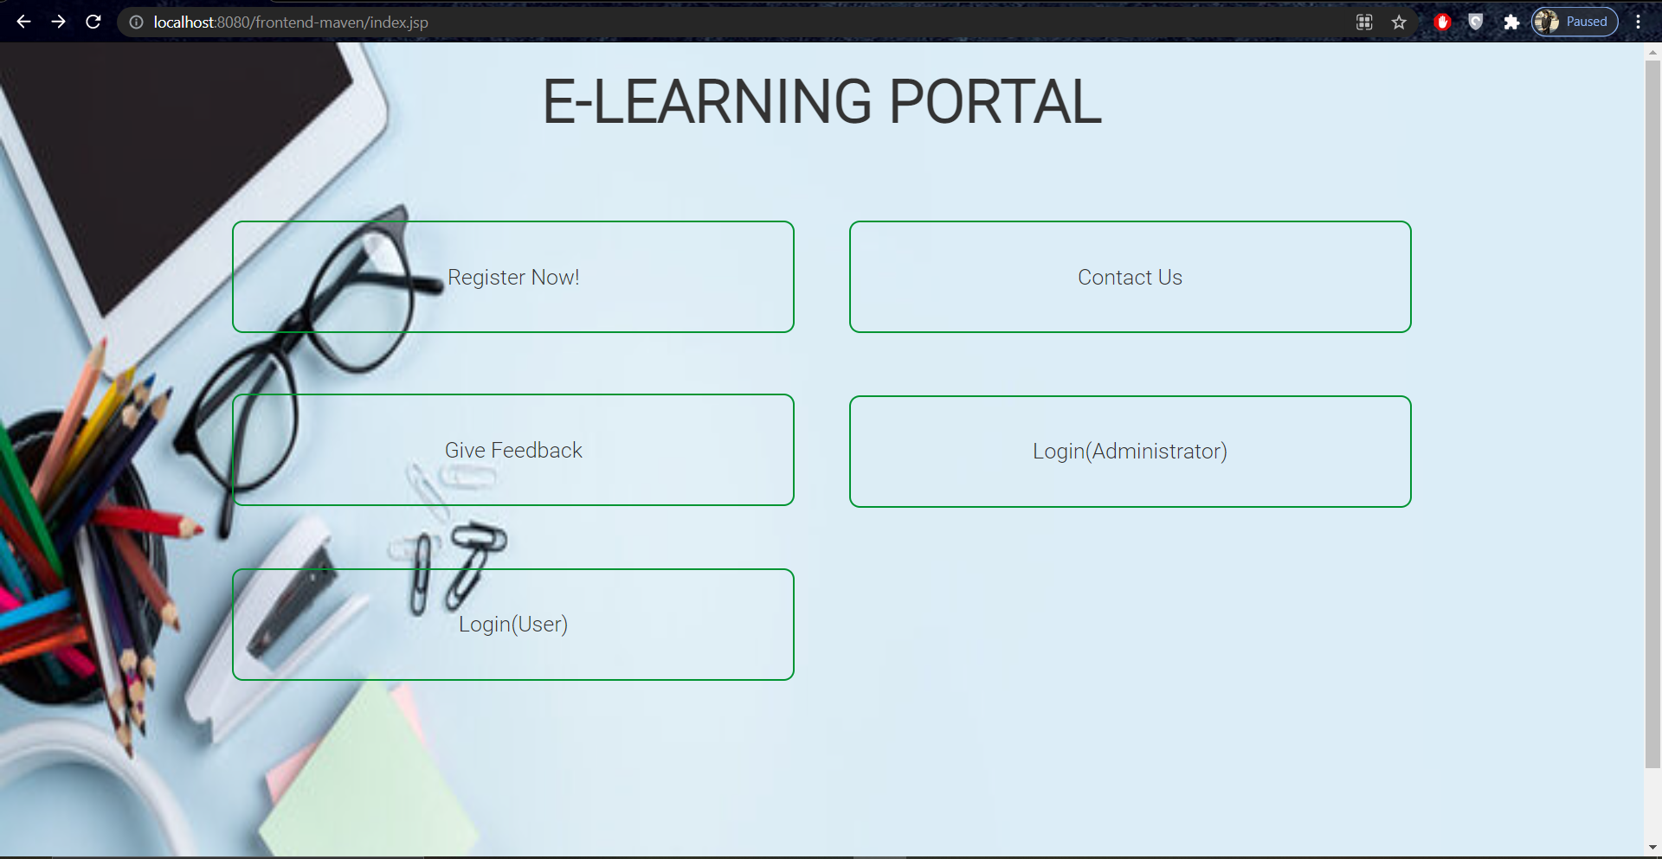
Home Page

Slide 5
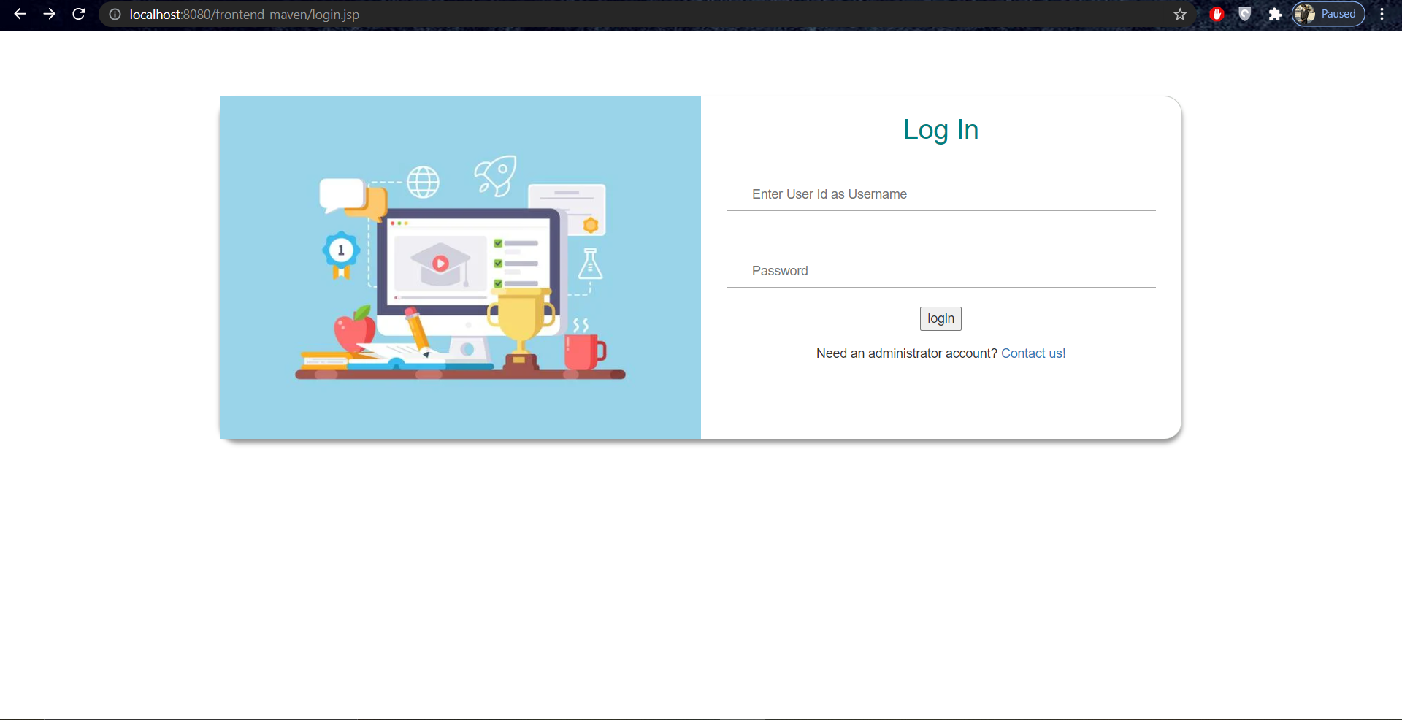
Login(Administrator) Page

Slide 6
Admin Actions
The admin can
View all users or a specific user
Add/Delete a course

Slide 7
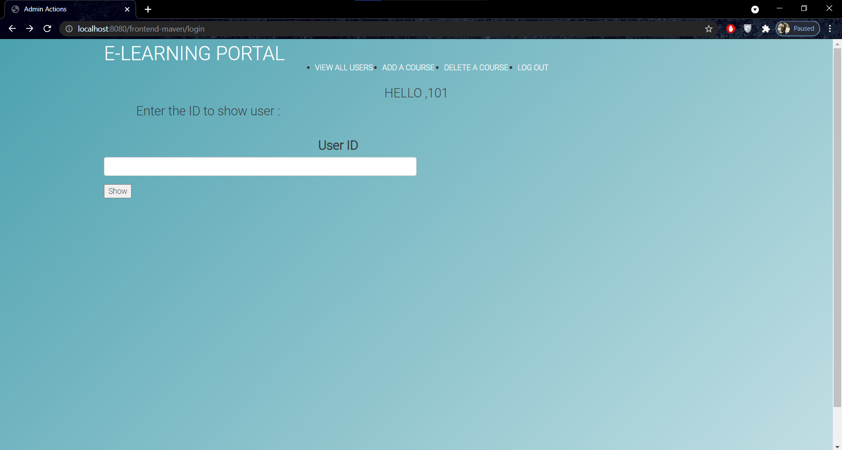

Slide 8
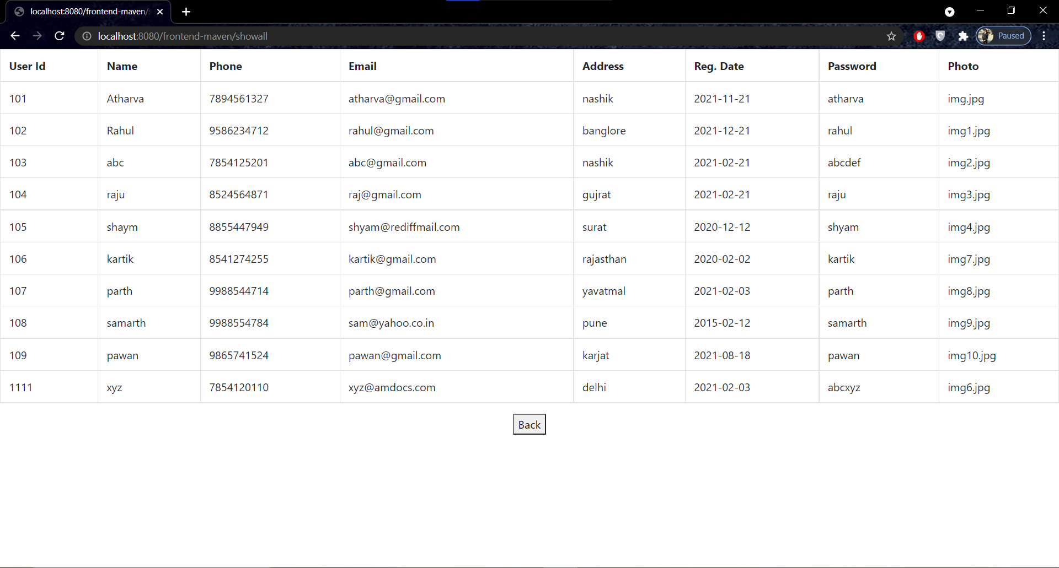
Show all users (admin)

Slide 9
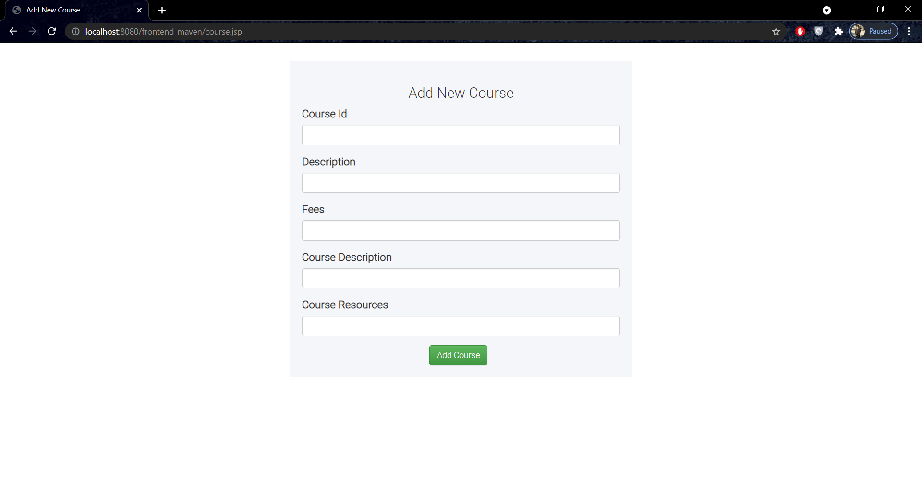
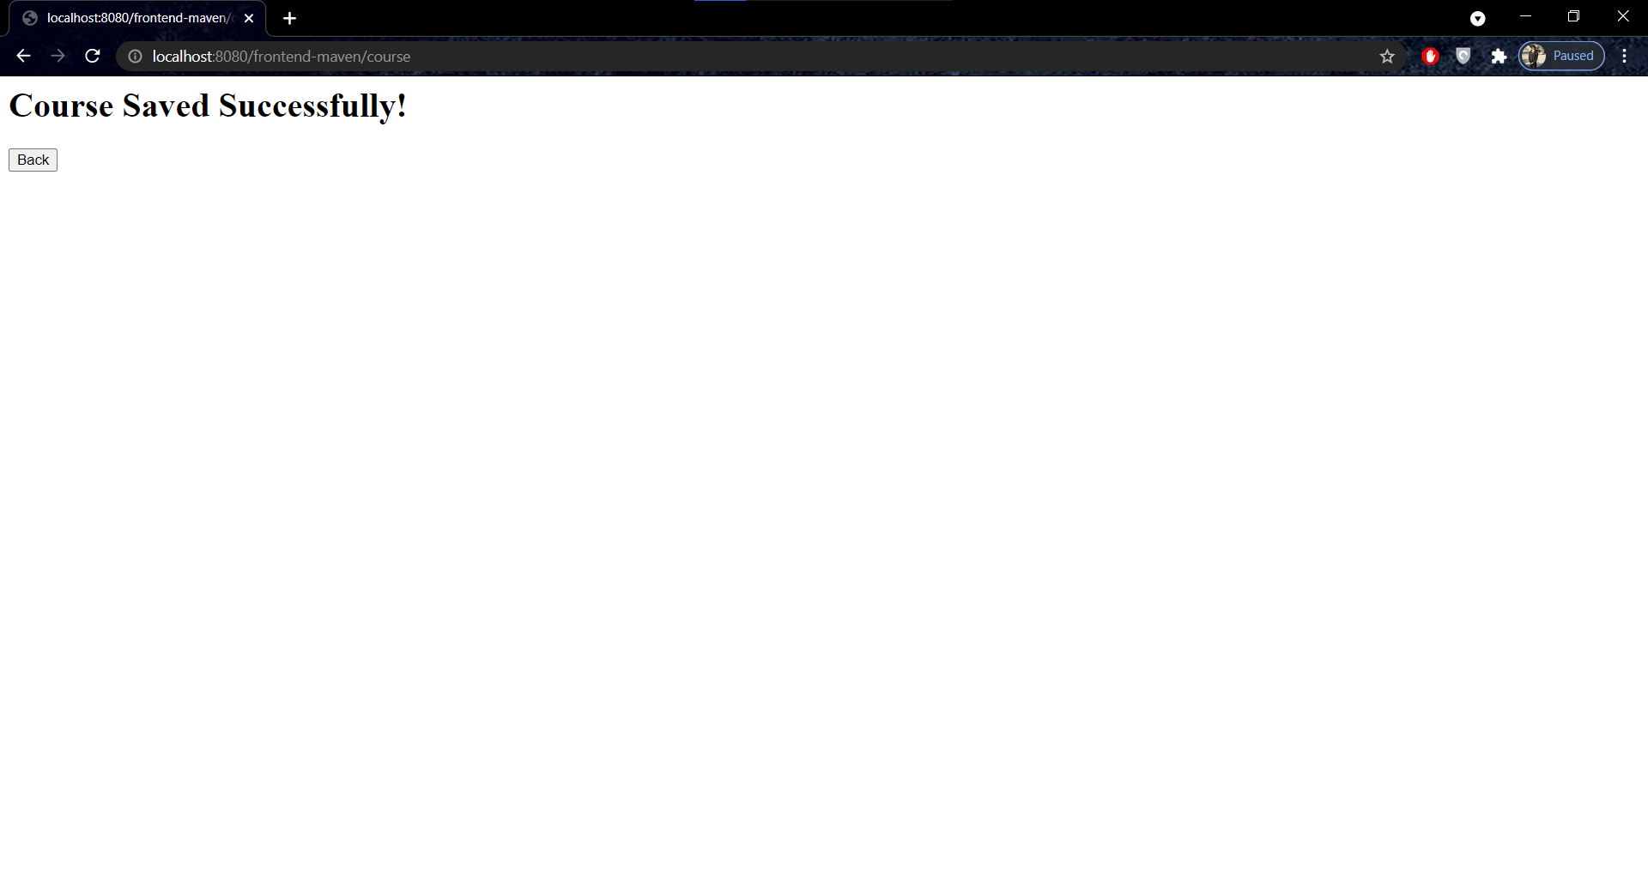
Add a course

Slide 10
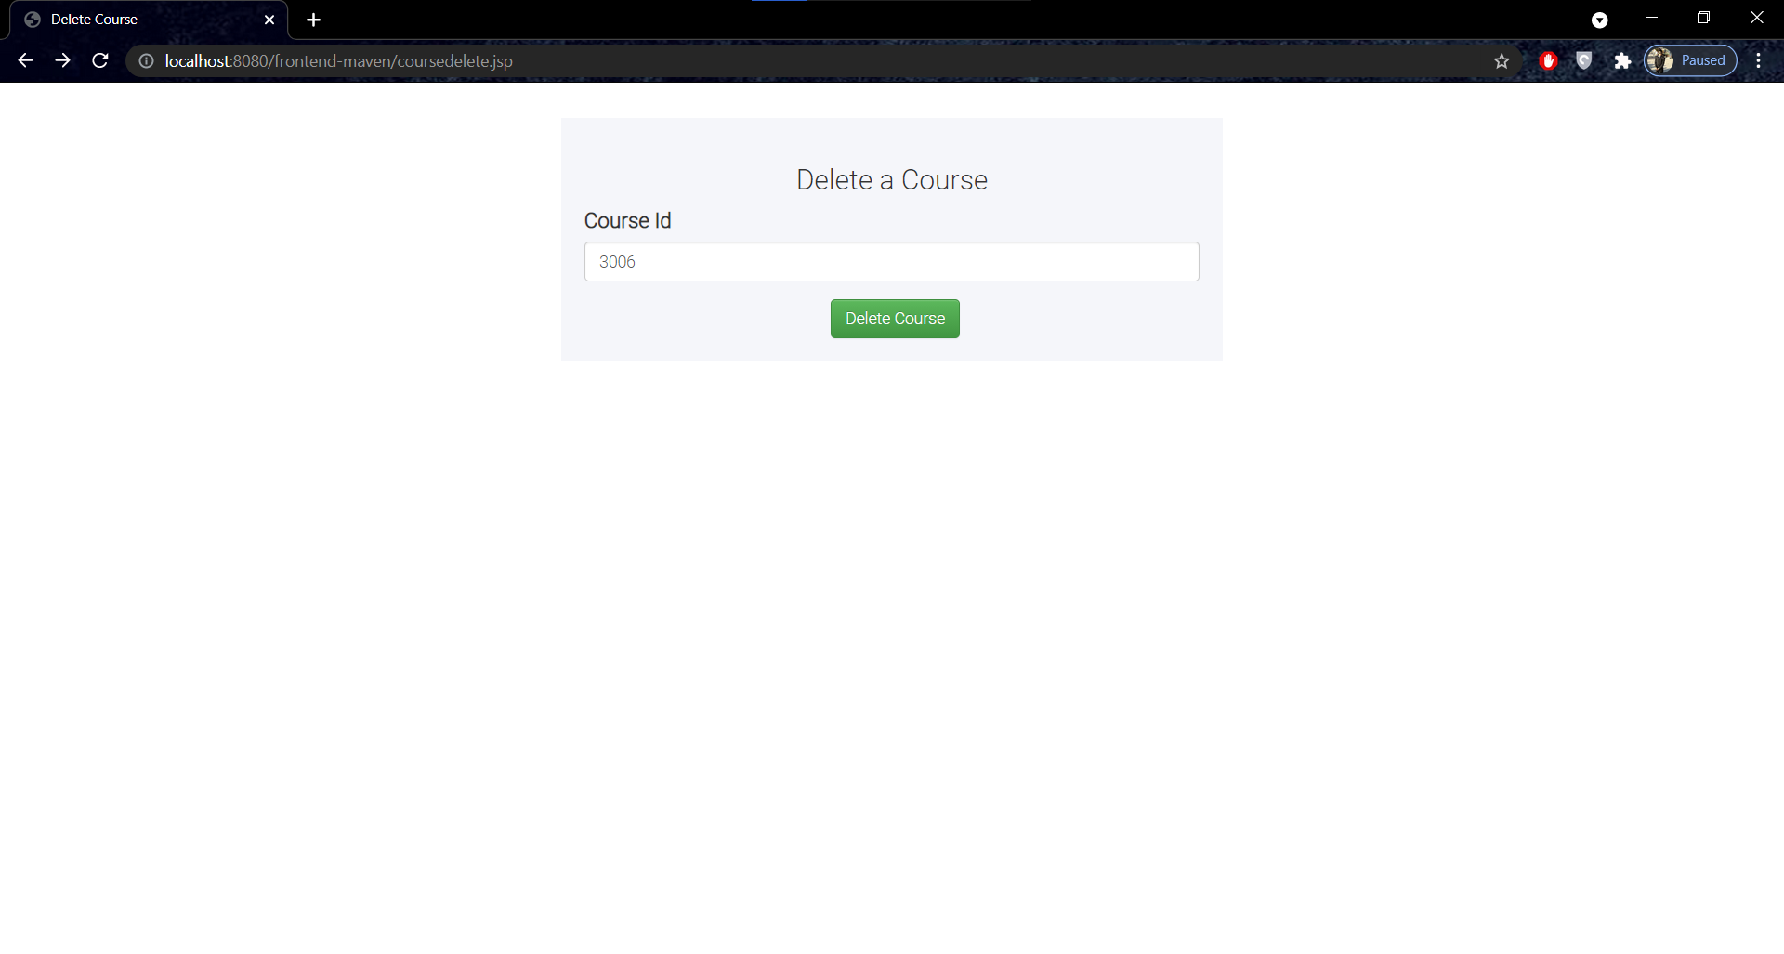
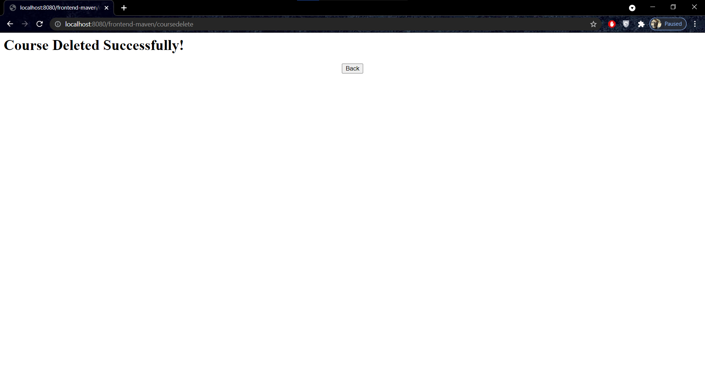
Delete a course

Slide 11
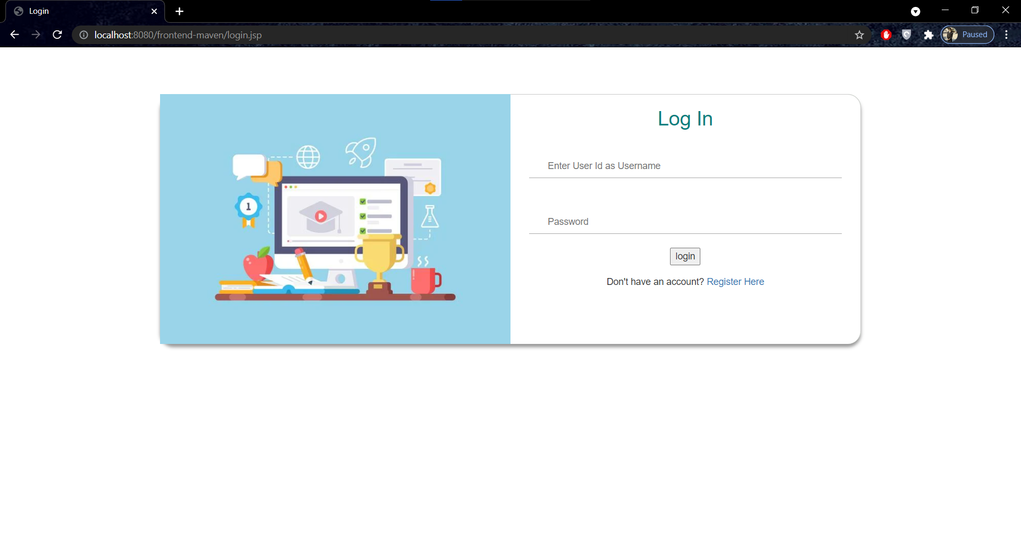
Login(User) Page

Slide 12
User Actions
User can
Enroll in a course
See his details

Slide 13
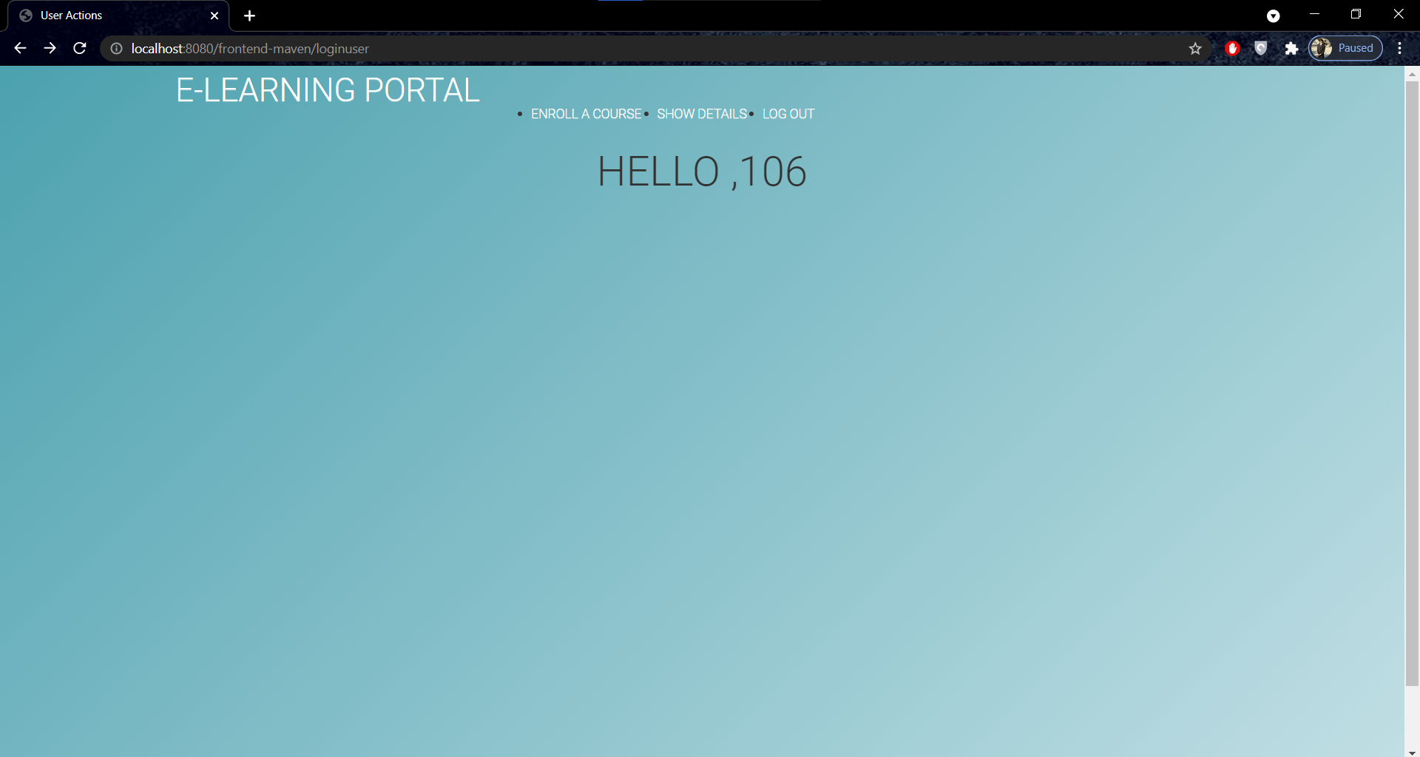

Slide 14
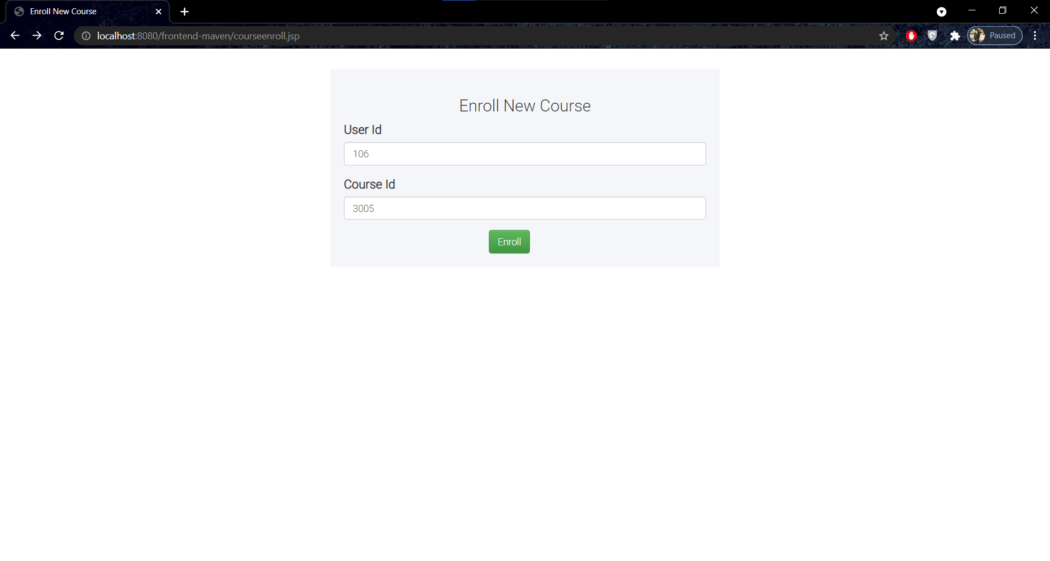
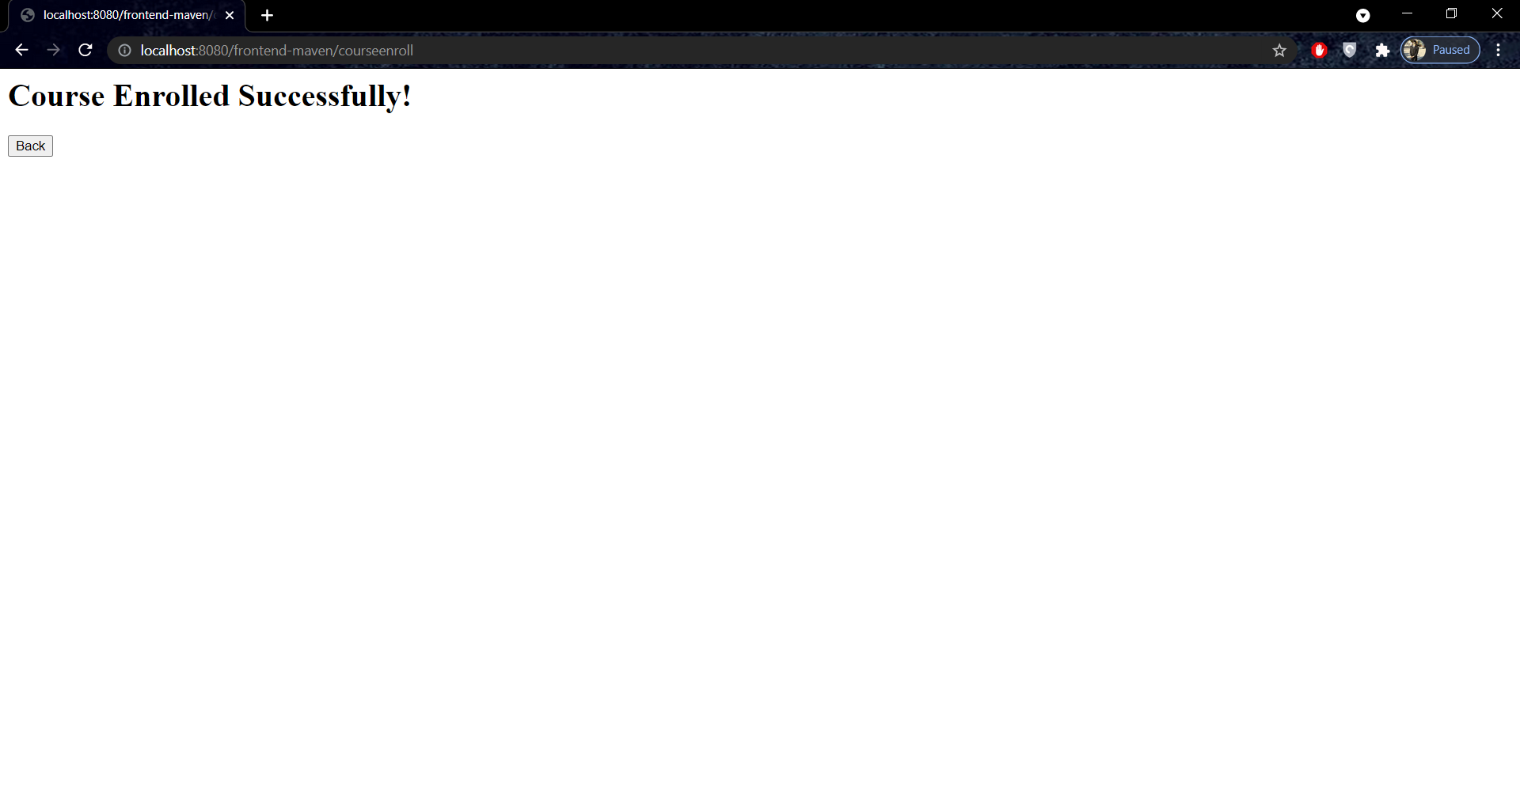
Enroll

Slide 15
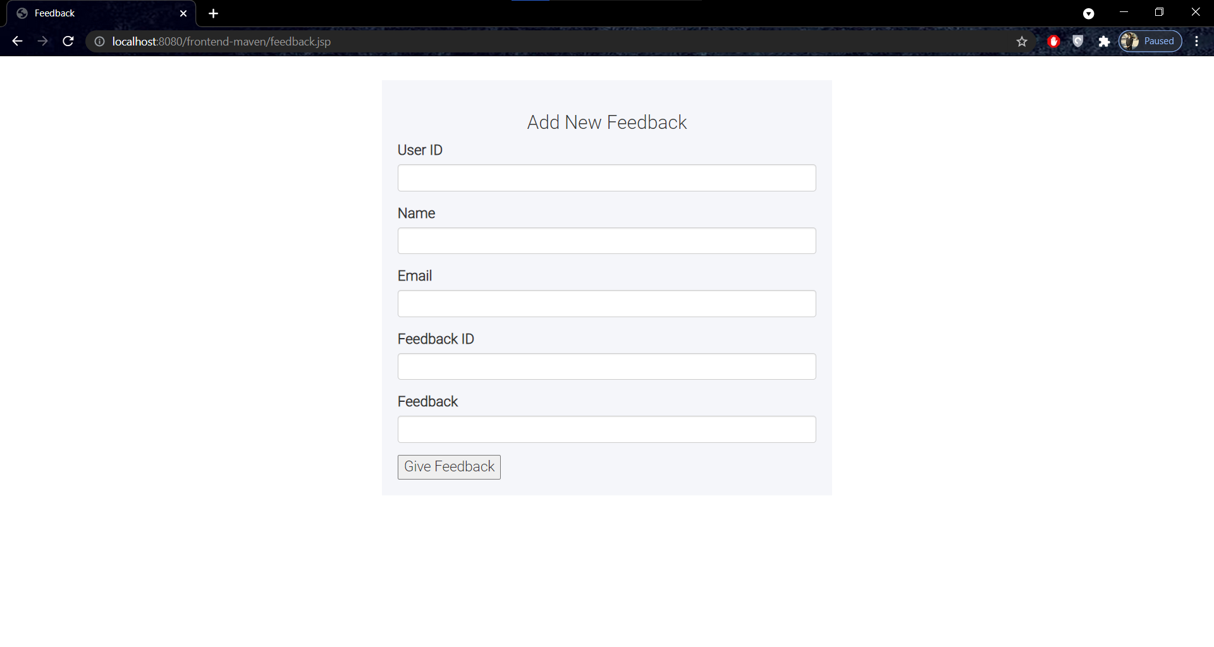
Feedback Page

Slide 16
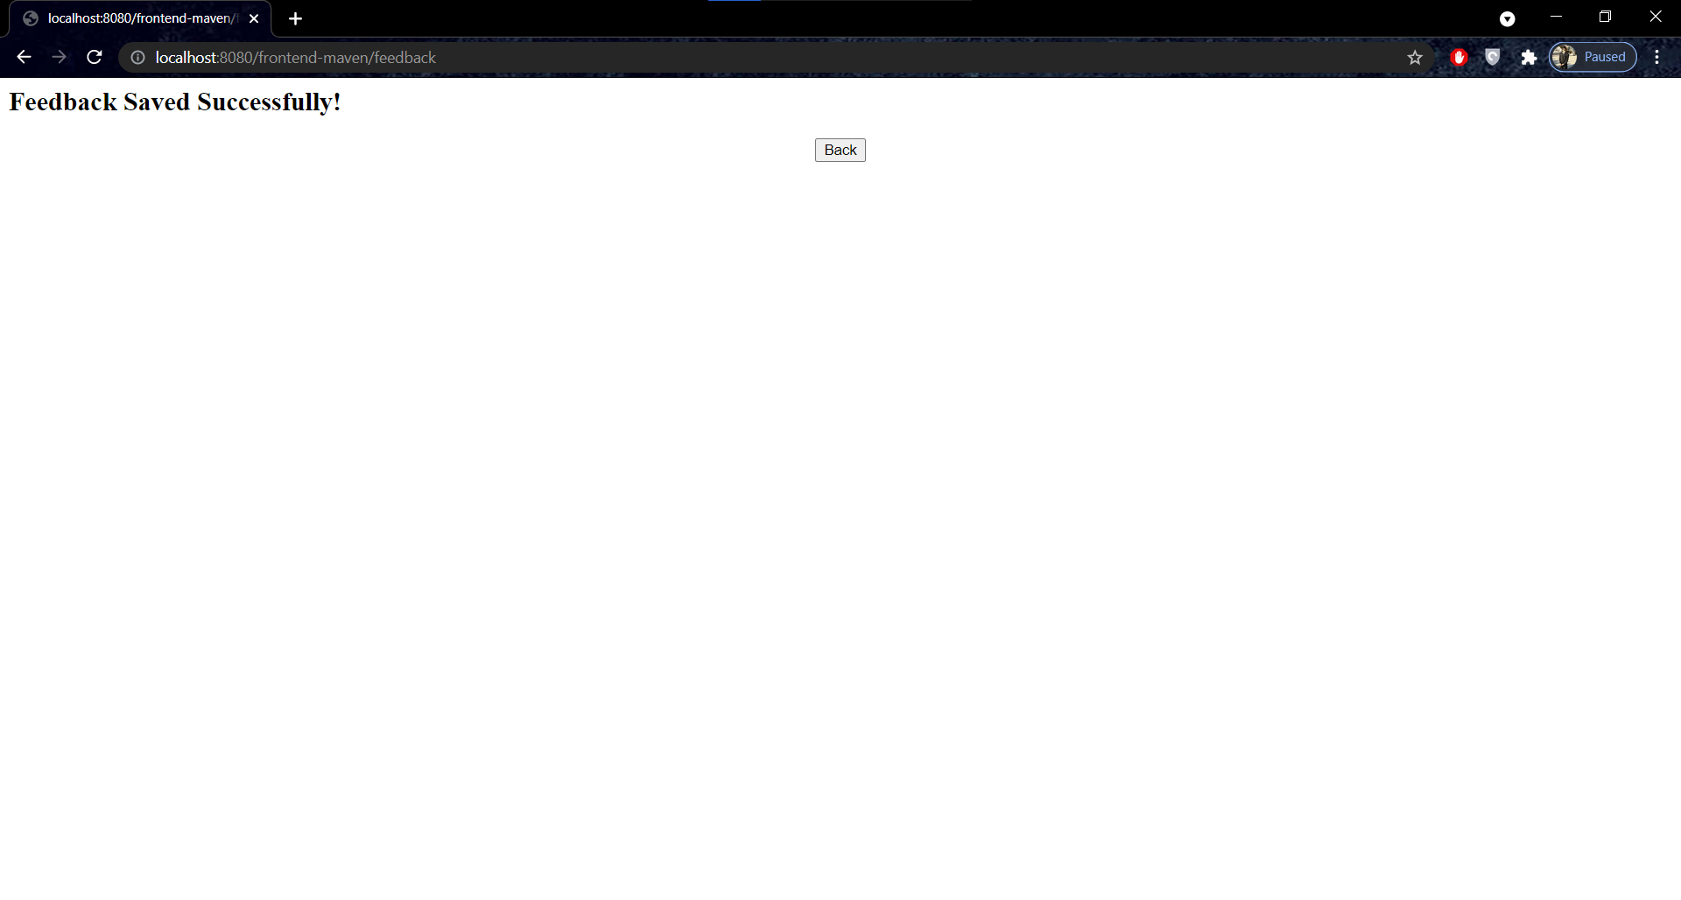

Slide 17
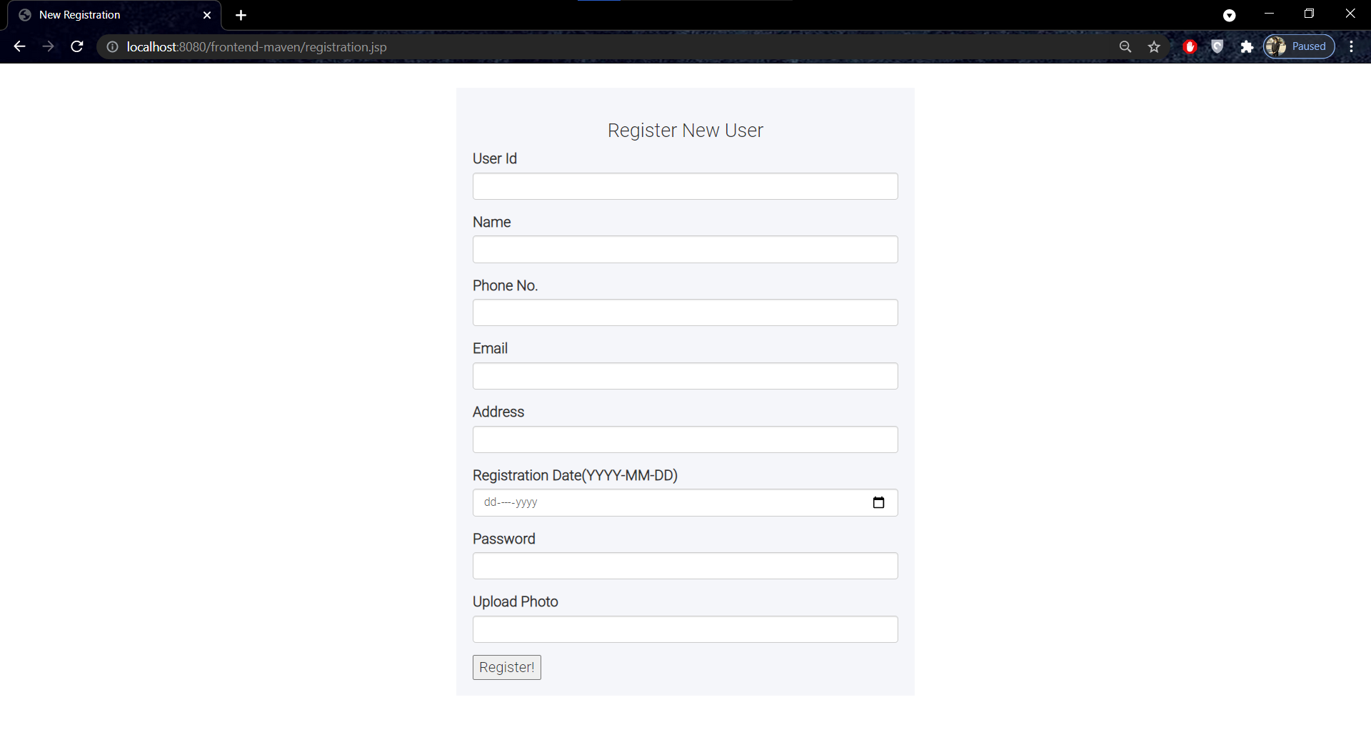
Registration Page

Slide 18
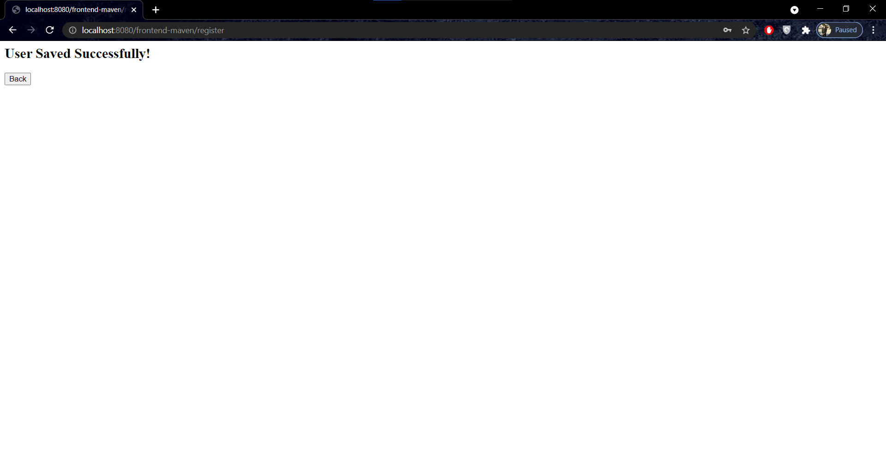

Slide 19
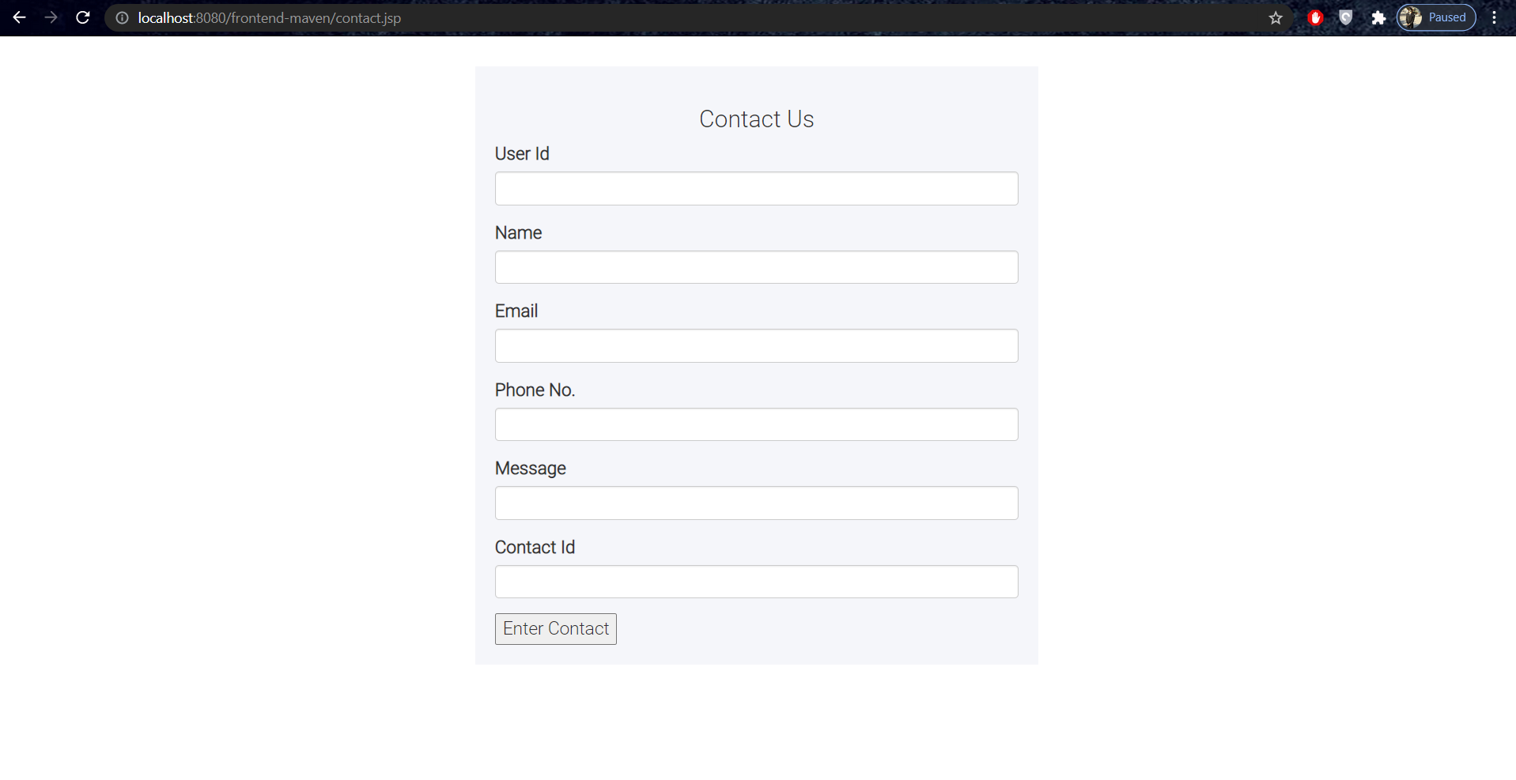
Contact Us Page

Slide 20


Slide 21
THANK YOU!

